Slide 1
Topic: Trading Analytics for Day Trading in Stock Market
REVA Academy for Corporate Excellence (RACE)
Name of the Presenter(s)
Anand Mohan
Batch:MBA06
Trimester: THIRD TRIMESTER
SRN: R19MBA53
Mentor: J B SIMHA
www.race.reva.edu.in

Slide 2

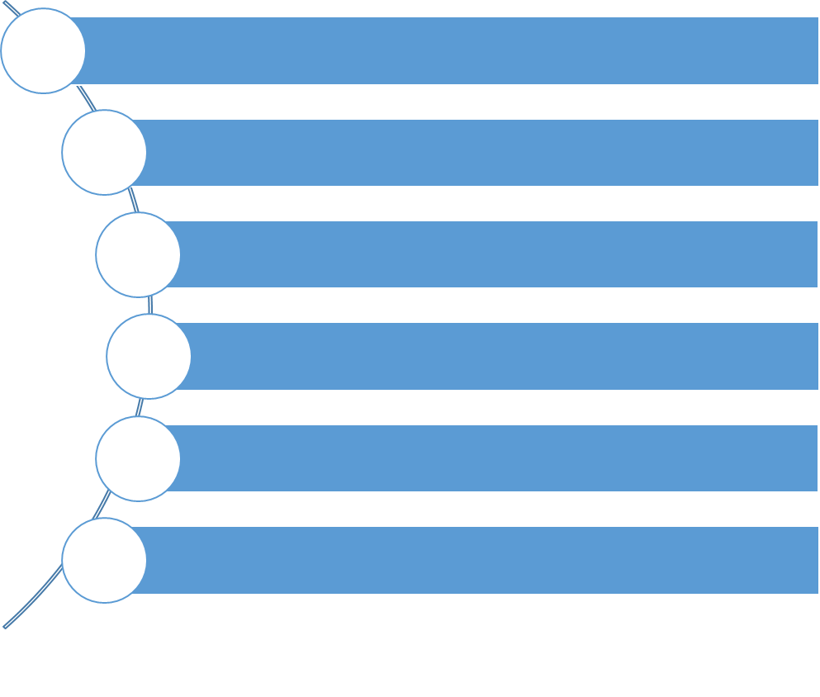
Agenda
Introduction
Problem Statement Technical Solution Design
Framework – CRISP-DM
Analysis
Future Scope

Slide 3

Introduction
Exchange-high volatility-New field for Researchers!
Numerous Stock Prediction Techniques today
consistency of prediction Performance remains debatable.
Short Prediction-High Frequency Trading via Broker -Eat up the potential profit due to high commission rate
Exploring Machine Learning ways for Stock Prediction.
Information extracted from returns data of HDFC Stocks between 2000 to 2021 being utilized
Various Machine Leaning Algorithms using Regression Models explored
Machine Learning Algorithms ranked based on their relative expected outcome

Slide 4

Problem Statement
Exchange is technically accessible to traditional voters.
Still, these markets are dominated by big investors, perpetuating the wealth divide.
With algorithmic Trading, unsuccessful, long-term predictions on company filings, any derived and associated formula may go fine on back testing in controlled environments, but the main challenge is live testing.
Algorithmic Trading gives many benefits but retail investors do not have the desired technology to create such systems.
Hence, we will introspect more on simple and easy to apply Modelling Mechanisms using Statistical and Machine Learning approaches.
investors should be able to utilize the paper’s findings to assist them to guide their quality allocation and create buy-sell selections that best meet their needed returns expectations with High Accuracy and Minimizing risks.

Slide 5




Technical Solution Design
Validation:
→Accuracy
→Precision
→Recall
→MAE
→MSE
→RMSE
→MAPE
Deployment:
→Dashboard
→State of the art API
Modeling / Classifiers:
→SMA EMA T Test Metrics
→SMA EMA Z Test Metrics
→Auto Keras Classification
Data Preprocessing:
→ Handling Missing values
→ Features Addition
→ MinMax Scaler
→KNN Classification
→Logistic Regression
→ARIMA
→ OLS Regression
→ Lasso Regression-CV
Data Extraction:
Daily Data of HDFC company from the year 2000 to 2021
→ k-Nearest Neighbours Model
→Decision Tree
→GridSearchCV
→Random Forest
→XGBoost Model
Phase -1 I
Phase - 2I

Slide 6

Framework-Crisp DM
Business Understanding
Data Understanding
Data Preparation
Modelling
Evaluation
Deployment

Slide 7
Business Understanding
There exist 2 main conventional approaches to the analysis of the stock markets:
Fundamental analysis
Technical analysis.
Modern Approaches for stock exchange Prediction:
Hypothesis Testing:
The null Hypothesis (H0) is assumed to be true. Hypothesis testing starts by stating and assuming a null hypothesis then the method determines whether or not the belief is probably going to be true or false.
The vital purpose to notice is that there is a component of doubt concerning validity of Null Hypothesis. whatever data that is against the declared null hypothesis is captured within the alternative Hypothesis (H1).
ARIMA Model:

Slide 8
Business Understanding
Machine Learning Approach
Prediction with Deep Learning
Long Short-Term Memory (LSTM
Auto Keras
Sentiment Analysis Approach:
The most-used platforms on the net are social media. it is calculable that social media users everywhere around the globe can number around 3.07 billion. there is a high association between stock costs and events associated with stocks on the net.
The Stock Twits, Twitter, and Yahoo Finance are the typical medium for sentiments research.

Slide 9
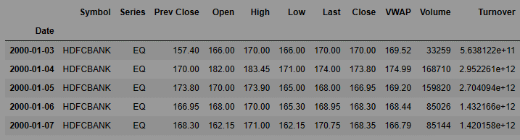
Data Understanding
Daily Data of HDFC company from the year 2000 to 2021 which is traded on the stock exchange in India, is being used for this study. To properly scan stocks, we should tend to first perceive what every column within the stock chart means:
The previous close nearly always refers to the
previous day's final price of security once the
market formally closes for the day.
The opening price is the first trade price that was recorded. This is usually employed in relevance to the present price or the closing price from the previous day session to quantify the stock's movement.
The last price is the one at which the foremost recent transaction happens.
The close is the last price once the market is closed on the day.

Slide 10
Data Understanding
If the closing price is up or down over five-percent more than the previous day's shut, the whole listing for that stock is listed in bold. It is to be noted that you are not almost certain to get this price if you get the stock consecutive day the reason being that the share price is consistently dynamic (even when the exchange is closed for the day).
The volume-weighted average worth (VWAP) may be a technical analysis indicator used on intraday charts that resets at the beginning of each new commerce session. it is a business benchmark that represents the typical price which the security listed throughout the day, based on both volume and price.
Trading Volume shows the number of shares listed for the day, listed in lots of 100 quantities of shares.
Share turnover may be an estimation of stock liquidity, calculated by dividing the whole number of shares traded throughout some period by the average number of shares outstanding for the same duration of time.

Slide 11
Data Preparation
Handling Missing values: Three of the features—Trades’, ‘Deliverable Volume’,’% Deliverable had quite one hundred periods missing values therefore those columns will need to be dropped as they are having several missing values.
It is needed to refrain from implementing the mean, media, and mode imputation methodology because those might render values that may introduce bias into our dataset. Second, the strategy solely looks at the variable itself and therefore might come up with values that don't seem to be representative of trends within the dataset.
Features Addition: In the dataset, computed variables are added that for sure would influence stock returns. These are moving averages for rolling periods of seven days,13 days,20 days,100 days, and two hundred days. Exponential moving averages is being conjointly enclosed for seven days,13 days,20 days,100 days, and two hundred days. These derived features were useful in evaluating the securities market returns.

Slide 12
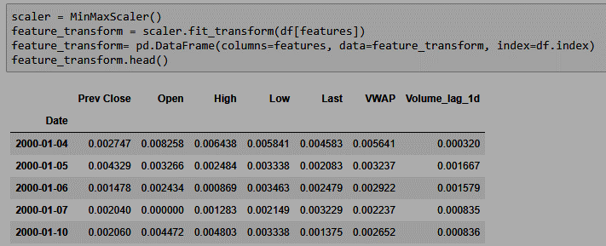
Data Preparation
MinMax Scaler is one of the approaches to data scaling that is being used.
Here, the minimum of features is created up to zero, and the most of features are up to one.
MinMax Scaler shrinks the data inside the given range, sometimes from zero to one.
It transforms data by scaling variables to a given range.
It scales the price to a selected value range while not varying the form of the initial distribution.

Slide 13
Modelling
HDFC excel data is put in Tabular form in step 1.
Step 2: The time series data is plotted for the HDFC stock that is provided as a dataset for the project for all ten years.
The 7-day moving average time series data is added in step 3.
Step 4: The data for a 7-day moving average time series is being plotted.
Step 5: The data from a rolling 7-day moving average is included in the Data frame.
Step 6: It is determined whether the closing price value on a certain prior day was lower or higher than the current 7-day moving average.

Slide 14
Modelling
Step 7: The same step is performed for the moving averages of 13 days, 20 days, 100 days, and 200 days.
Step 8: Exponential Moving Average is used to recreate the five different models created using Simple Moving Average.
Step 9: ARIMA Time series modelling is used to create an additional five different models.
The construction of all 15 models, as seen above, will be used to forecast day trading in the stock market.
When the majority of the 15 various models or all of them move in the same direction, a choice on whether to purchase or sell the stock must be made.

Slide 15
Modelling
various Classification models namely AutoKeras Classification Model (Structured Data Classifier), K-neighbours Classifier Model, and Logistic Regression Classification Model deployed and their prediction accuracy is being compared with Simple Moving Average Models, Exponential Moving Average Models, and ARIMA Models.
further ahead various Regression Models including both Machine Learning and Deep learning techniques are deployed and Metrics namely Mean Absolute error and Mean Absolute percentage errors are deployed to estimate the quality of the predictions on the close price of the HDFC share.
These Regression Models are Ordinary Least Squares(OLS)-Linear Regression Model, Lasso Regression Model, Lasso regression Model Using Cross Validation, The k-Nearest Neighbours(KNN) Algorithm, Decision Tree Algorithm, GridSearchCV Algorithm with Hyperparameter Tuning, Random Forest Regression Model, XGBoost ML Model, Using Principal Component Analysis (PCA) with LSTM, Using Principal Component Analysis (PCA) with LSTM with Moving Average variables(Feature Engineering), Long Short-Term Memory(LSTM) Neural Network Model, Regression Model using AutoKeras.

Slide 16
Data Evaluation
Initially, A rule-based model is being developed to try to do hypothesis testing to work out whether or not the chosen stock’s price is crossing any of the moving averages. Then prediction based on the Hypothesis Testing Rule is decided that is employed as a Metric to work out the accuracy for predicting the upward Trend or Downward trend of the HDFC shares.

Slide 17
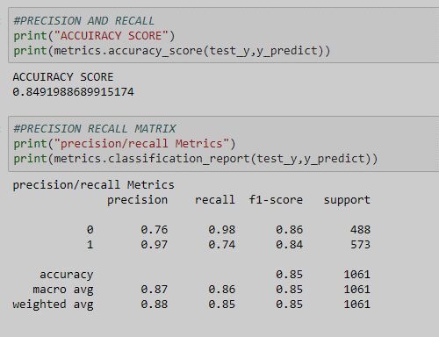
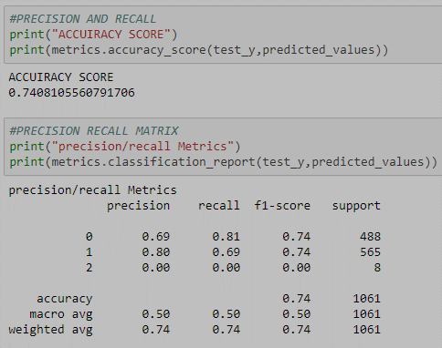
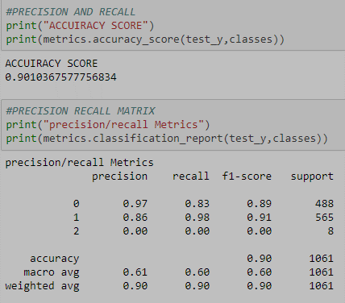
Data Evaluation
A few Classifications Based Models will be conjointly built. Metrics being employed for classification Models would be accuracy score and confusion matrix which can facilitate in determining the accuracy of predicting the upward Trend or Downward trend of the HDFC shares.
Auto Keras Accuracy score
K neighbors Classifier Accuracy score
Logistic Regression Accuracy score

Slide 18
Data Evaluation
ARIMA Modelling:
Five ARIMA models are created using Moving Average as the Target variable because it would smoothen the curve for the close price of the HDFC stock price. When a model for prediction functions in statistic Time series analysis is created, a stationary statistic Time series for a higher prediction is required.
ADF (Augmented Dickey-Fuller) test is a statistical significance test which means the test will end up in hypothesis tests with null and alternative hypotheses. As a result, we will have a p-value from that we will have to be compelled to create inferences regarding the Time series, whether or not it is stationary or not.
To perform the ADF test in any statistic package, the stats model provides the implementation operation adfuller (). Function adfuller () provides the subsequent data particularly p-value, Value of the test statistic, Number of lags for testing consideration, and critical values.
if the results of the ADF test are bigger than 0.05 then we were required to fail to reject Null Hypothesis H0 and are available to reasoning that point Series is not Stationary. If the results of the ADF test would are lesser than 0.05 then we were required to reject Null Hypothesis H0 and are available to reasoning that Time Series data is Stationary.

Slide 19
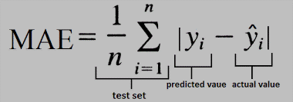
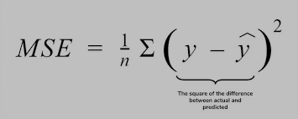
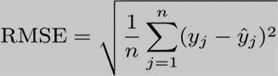
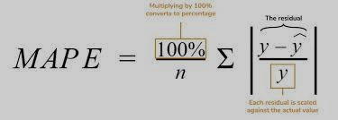
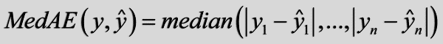
Data Evaluation
Different Regression Models are built using each of the Machine Learning and Deep Learning algorithms to work out the Accuracy in predicting the expected close price of the HDFC stock that is that the Target or dependent variable for the Modelling Algorithms.
The metrics that is required to be verified for the accuracy of predictions in the case of regression Modelling are Mean Absolute Error (MAE), Mean square Error (MSE), Root Mean square Error (RMSE), Median Absolute Error (MAE), Mean Absolute Percentage Error (MAPE).

Slide 20
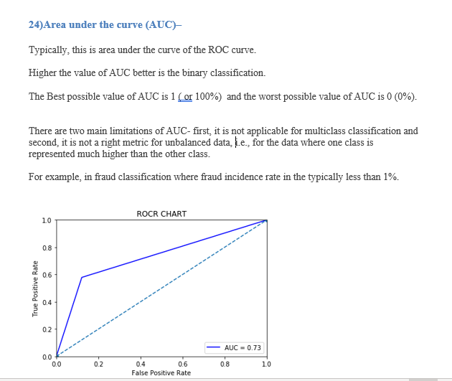
Data Evaluation

Slide 21
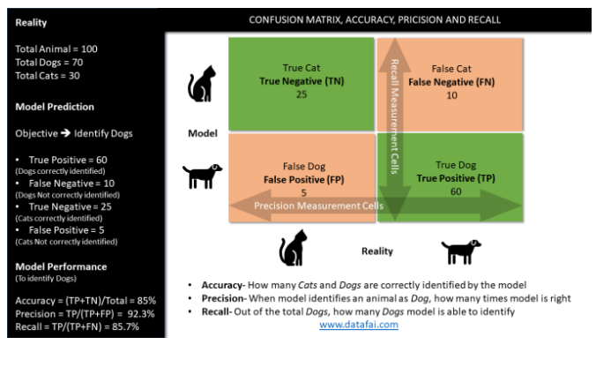
Data Evaluation

Slide 22
Deployment
SMA EMA T Test Metrics:
SERIAL NUMBERS | DESCRIPTIONS | TOTAL | TRUE COUNT | FALSE COUNT | EFFICIENCY
SMA7 | Simple moving average-7 samples | 5297 | 4114 | 1183 | 77.67
SMA13 | Simple moving average-13 samples | 5291 | 3474 | 1817 | 65.66
SMA20 | Simple moving average-20 samples | 5284 | 3217 | 2067 | 60.88
EMA7 | Exponential moving average-7 samples | 5297 | 4077 | 1220 | 76.97
EMA13 | Exponential moving average-13 samples | 5291 | 3486 | 1805 | 65.89
EMA20 | Exponential moving average-20 samples | 5284 | 3236 | 2048 | 61.24
It can be observed that T-test Hypothesis testing done for a rolling 7-day moving average data has given the highest efficiency in correctly predicting the upward or downward trend closely followed by exponential moving averages with a span of
7-days. however, prediction efficiency
is least for 20 days of Simple moving average data and 20-days exponential moving average data.

Slide 23
Deployment
SMA EMA Z Test Metrics:
SERIAL NUMBERS | DESCRIPTIONS | TOTAL | TRUE COUNT | FALSE COUNT | EFFICIENCY
SMA100 | Simple moving average-100 samples | 5204 | 2798 | 2406 | 53.77
SMA200 | Simple moving average-200 samples | 5104 | 2754 | 2350 | 53.96
EMA100 | Exponential moving average-100 samples | 5204 | 2829 | 2375 | 54.36
EMA200 | Exponential moving average-200 samples | 5104 | 2779 | 2325 | 54.45
It can be observed that Z-test Hypothesis testing done for a rolling 100-day moving average And 200-day moving average has given lesser efficiency in correctly predicting the upward or downward trend compared to the prediction done with Hypothesis testing done on smaller samples using T-test Hypothesis testing.
Similar inferences can be drawn for Exponential moving average with 100 days and 200 days span as well.

Slide 24
Deployment
It can be observed that Logistic Regression Classification Model and Auto Keras classification Model have given the accuracy of near about 85 to 90% in able to correctly predict the direction of the close price.
The highest Accuracy in predicting the direction by Hypothesis Testing using simple moving Average and Exponential Moving averages was near about 77%.
Hence, it can be safely concluded that Deep Learning models and Machine Learning Models were able to provide better outputs compared to Statistical methods of Hypothesis Testing.
Classification Model Metrics:
SERIAL NUMBERS | DESCRIPTIONS | TOTAL | TRUE COUNT | FALSE COUNT | EFFICIENCY
Structured Data Classifier | Auto Keras Classification Model | 1061 | 901 | 160 | 84.92
K Neighbors Classifier | KNN Classification Model | 1061 | 786 | 267 | 74.08
Logistic Regression | Logistic Regression Classification Model | 1061 | 956 | 97 | 90.10

Slide 25
Deployment
ARIMA Models Metrics:
SERIAL NUMBERS | DESCRIPTIONS | MEAN ABSOLUTE ERROR (MAE) FOR TEST DATA | MEAN SQUARE ERROR (MSE) FOR TEST DATA | ROOT MEAN SQUARE ERROR (RMSE) FOR TEST DATA | Median Absolute Error FOR TEST DATA | MAPE FOR TEST DATA
EMA_200ARIMA | Auto Arima model using Exponential moving average-200 samples | 84.21 | 9662.99 | 98.30 | 96.06 | Nan
SMA_100ARIMA | Auto Arima model using Simple moving average-100 samples | 112.25 | 19404.28 | 139.30 | 95.51 | 9.42
SMA_20ARIMA | Auto Arima model using Simple moving average-20 samples | 183.76 | 45227.79 | 212.67 | 181.82 | 16.29
SMA_13ARIMA | Auto Arima model using Simple moving average-13 samples | 184.73 | 44482.52 | 210.91 | 172.64 | 16.171
SMA_7ARIMA | Auto Arima model using Simple moving average-7 samples | 185.64 | 47486.11 | 217.91 | 173.93 | 15.09

Slide 26
Deployment
ARIMA Models Metrics:
In all results of the ADF test for ARIMA Modelling on our dataset for HDFC stock, it was observed that the p-value obtained is bigger than 0.05 thus we the null hypothesis is not rejected and it is concluded that the statistic for Dataset under consideration is non-stationary.
It can be observed that mean Absolute Error, Mean Square Error, Root Mean Square Error, Median Absolute Error, and Mean Absolute Percentage Error are far too high in the case of all Auto ARIMA Modelling. Hence, it can be concluded that the dataset under consideration was not suitable for Time series Modelling using the ARIMA Modelling algorithm.

Slide 27
Deployment
Regression Models-Part1 Metrics:It can be observed that mean Absolute Error and Mean Absolute Percentage Error was satisfactory for the Ordinary Least Squares (OLS)-Linear Regression Model. However, other Regression Models were not able to provide MAPE within the acceptable range.
SERIAL NUMBERS | DESCRIPTIONS | MEAN ABSOLUTE ERROR (MAE) FOR TEST DATA | MEAN SQUARE ERROR (MSE) FOR TEST DATA | ROOT MEAN SQUARE ERROR (RMSE) FOR TEST DATA | Median Absolute Error FOR TEST DATA | MAPE FOR TEST DATA
OLS Model | Ordinary Least Squares (OLS)-Linear Regression Model | 2.03 | 11.83 | 3.44 | 1.14 | 0.227
LASSO Model | Lasso Regression Model | 7.56 | 132.63 | 11.52 | 4.67 | 0.85
CVLASSO Model | Lasso regression Model Using Cross-Validation | 7.55 | 132.59 | 11.51 | 4.66 | 0.85
KNN Model | The k-Nearest Neighbors (KNN) Algorithm | 5.42 | 132.08 | 11.49 | 3.16 | 0.59

Slide 28
Deployment
Regression Models-Part2 Metrics:It can be observed that mean Absolute Error and Mean Absolute Percentage Error were satisfactory for Random Forest Regression Model. However, other Regression Models were able to provide fairly acceptable MAPE but still lower MAPE would have been better.
SERIAL NUMBERS | DESCRIPTIONS | MEAN ABSOLUTE ERROR (MAE) FOR TEST DATA | MEAN SQUARE ERROR (MSE) FOR TEST DATA | ROOT MEAN SQUARE ERROR (RMSE) FOR TEST DATA | Median Absolute Error FOR TEST DATA | MAPE FOR TEST DATA
DT Model | Decision Tree Algorithm | 3.26 | 23.95 | 4.89 | 2.10 | 0.383
GRIDSEARCHCV Model | GridSearchCV Algorithm with Hyper-parameter Tuning | 3.22 | 23.16 | 4.81 | 2.10 | 0.38
RF Model | Random Forest Regression Model | 2.45 | 15.25 | 3.90 | 1.49 | 0.29
XGBOOST Model | XGBoost ML Model | 3.25 | 22.78 | 4.77 | 2.12 | 0.37

Slide 29
Deployment
Regression Models-Part3 Metrics:It can be observed that mean Absolute Error and Mean Absolute Percentage Error was satisfactory for both Using Principal Component Analysis (PCA) with LSTM and Regression Model using AutoKeras.However, other Regression Models were able to provide fairly acceptable MAPE but still, their MAE would have been better.
SERIAL NUMBERS | DESCRIPTIONS | MEAN ABSOLUTE ERROR (MAE) FOR TEST DATA | MEAN SQUARE ERROR (MSE) FOR TEST DATA | ROOT MEAN SQUARE ERROR (RMSE) FOR TEST DATA | Median Absolute Error FOR TEST DATA | MAPE FOR TEST DATA
PCA LSTM Model | Using Principal Component Analysis (PCA) with LSTM | 4.37 | 34.70 | 5.89 | 3.60 | 33.44
PCA LSTM Moving Averages Model | Using Principal Component Analysis (PCA) with LSTM with Moving Average variables (Feature Engineering) | 7.75 | 135.03 | 11.62 | 5.99 | 33.47
LSTM Model | Long Short-Term Memory-LSTM Neural Network Model | 9.71 | 159.01 | 12.61 | 8.20 | 33.40
Auto Keras Model | Regression Model using AutoKeras | 2.59 | 242.51 | 15.57 | 1.10 | 0.27

Slide 30
Analysis and Results
Classification Metrics Comparison:
SERIAL NUMBERS | DESCRIPTIONS | EFFICIENCY>67%
SMA7 | Simple moving average-7 samples | YES-77.67
SMA13 | Simple moving average-13 samples | NO-65.66
SMA20 | Simple moving average-20 samples | NO-60.88
EMA7 | Exponential moving average-7 samples | YES-76.97
EMA13 | Exponential moving average-13 samples | NO-65.89
EMA20 | Exponential moving average-20 samples | NO-61.24
SMA100 | Simple moving average-100 samples | NO-53.77
SMA200 | Simple moving average-200 samples | NO-53.96
EMA100 | Exponential moving average-100 samples | NO-54.36
EMA200 | Exponential moving average-200 samples | NO-54.45
Structured Data Classifier | Auto Keras Classification Model | yes-84.92
K Neighbours Classifier | KNN Classification Model | yes-74.08
Logistic Regression | Logistic Regression Classification Model | yes-90.10

Slide 31
Analysis and Results
Classification Metrics Comparison:
SERIAL NUMBERS | DESCRIPTIONS | EFFICIENCY>67%
SMA7 | Simple moving average-7 samples | YES-77.67
SMA13 | Simple moving average-13 samples | NO-65.66
SMA20 | Simple moving average-20 samples | NO-60.88
EMA7 | Exponential moving average-7 samples | YES-76.97
EMA13 | Exponential moving average-13 samples | NO-65.89
EMA20 | Exponential moving average-20 samples | NO-61.24
SMA100 | Simple moving average-100 samples | NO-53.77
SMA200 | Simple moving average-200 samples | NO-53.96
EMA100 | Exponential moving average-100 samples | NO-54.36
EMA200 | Exponential moving average-200 samples | NO-54.45
Structured Data Classifier | Auto Keras Classification Model | yes-84.92
K Neighbours Classifier | KNN Classification Model | yes-74.08
Logistic Regression | Logistic Regression Classification Model | yes-90.10

Slide 32
Analysis and Results
Regression Metrics Comparison:
SERIAL NUMBERS | DESCRIPTIONS | MAE<=5 | MAPE<=0.33
OLS Model | Ordinary Least Squares (OLS)-Linear Regression Model | YES-2.034 | YES-0.23
LASSO Model | Lasso Regression Model | NO-7.555 | NO-0.85
CVLASSO Model | Lasso regression Model Using Cross-Validation | NO-7.55 | NO-0.85
KNN Model | The k-Nearest Neighbours (KNN) Algorithm | NO-5.423 | NO-0.59
DT Model | Decision Tree Algorithm | YES-3.26 | NO-0.38
GRIDSEARCHCV Model | GridSearchCV Algorithm with Hyper-parameter Tuning | YES-3.218 | NO-0.38
RF Model | Random Forest Regression Model | YES-2.45 | YES-0.29
XG Boost Model | XGBoost ML Model | YES-3.25 | NO-0.37
PCA LSTM Model | Using Principal Component Analysis (PCA) with LSTM | YES-4.366 | YES-33.44
PCA LSTM Moving Averages Model | Using Principal Component Analysis (PCA) with LSTM with Moving Average variables (Feature Engineering) | NO-7.75 | YES-33.47
LSTM Model | Long Short-Term Memory-LSTM Neural Network Model | NO-9.71 | YES-33.40
Auto Keras Model | Regression Model using AutoKeras | YES-2.59 | YES-0.27

Slide 33
Analysis and Results
It can be observed that Logistic Regression Classification Model and Auto Keras classification Model have given the accuracy of near about 85 to 90% in able to correctly predict the direction of the close price.
The highest Accuracy in predicting the direction by Hypothesis Testing using simple moving Average and Exponential Moving averages was near about 77%. other Hypothesis testing using T-test and Z-test statistical algorithms were not satisfactory in able to predict the direction of the close price of the HDFC share.
It can be observed that Ordinary Least Squares (OLS)-Linear Regression Model, Random Forest Regression Model, Using Principal Component Analysis (PCA) with LSTM and Regression Model using AutoKeras provide MAE<=5 and MAPE<=0.33. Hence these Regression Models were most successful in predicting the close value of the stock price.

Slide 34

Recommendations for Future Work
It is assumed that returns are more or less constant over time. However, Returns are highly dependent on time.
In future projects, it can be shown how to define Bullish and Bearish regimes using modern machine learning techniques. Then the techniques already discussed can be used in this project to estimate the direction of close price for each of the Normal and Crash regimes.
The Sentiment Analysis Approach may also be explored using Text Analytics for predicting stock market returns.

Slide 35


